Slide 1
Parking Lot Tracker
Computer Vision Final Project
Reut Rabenou – 312416621
Dan Halperin – 123456789

Slide 2
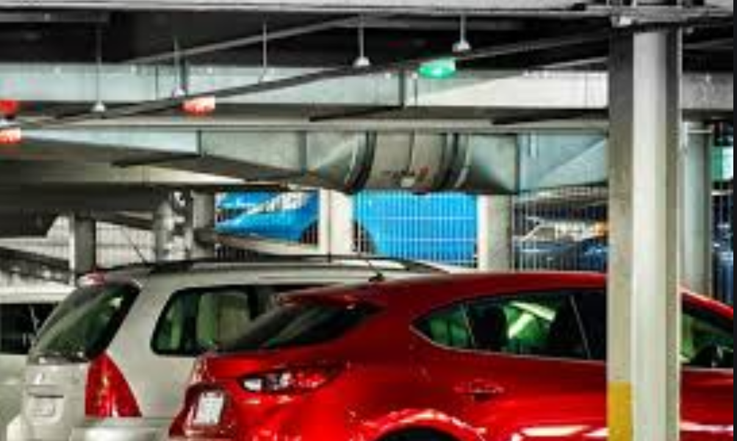
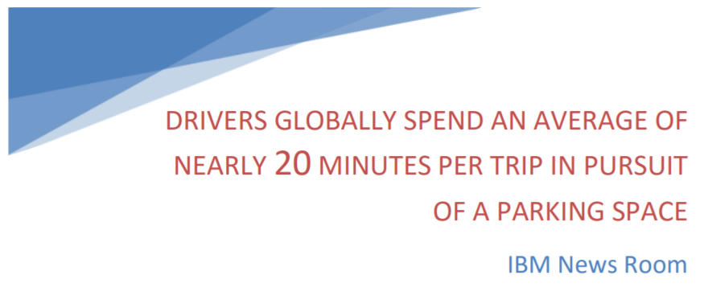
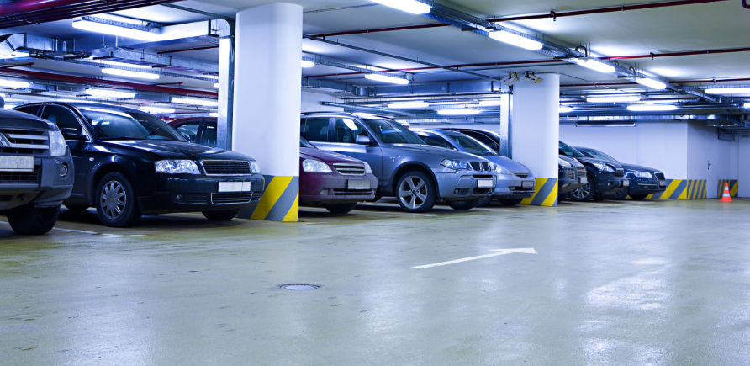
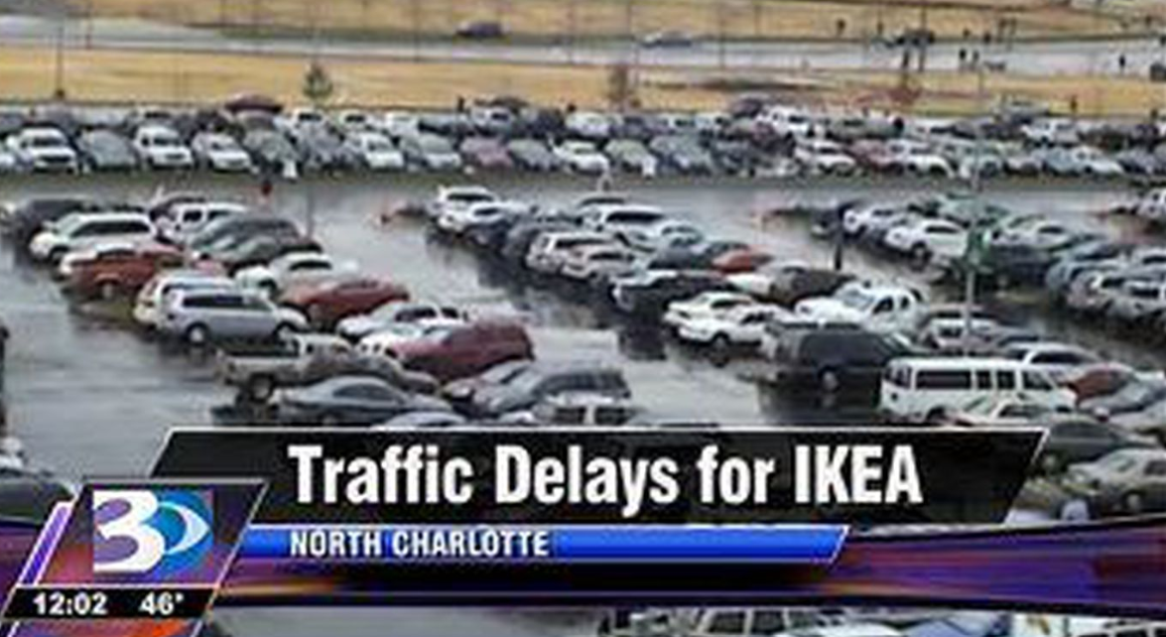
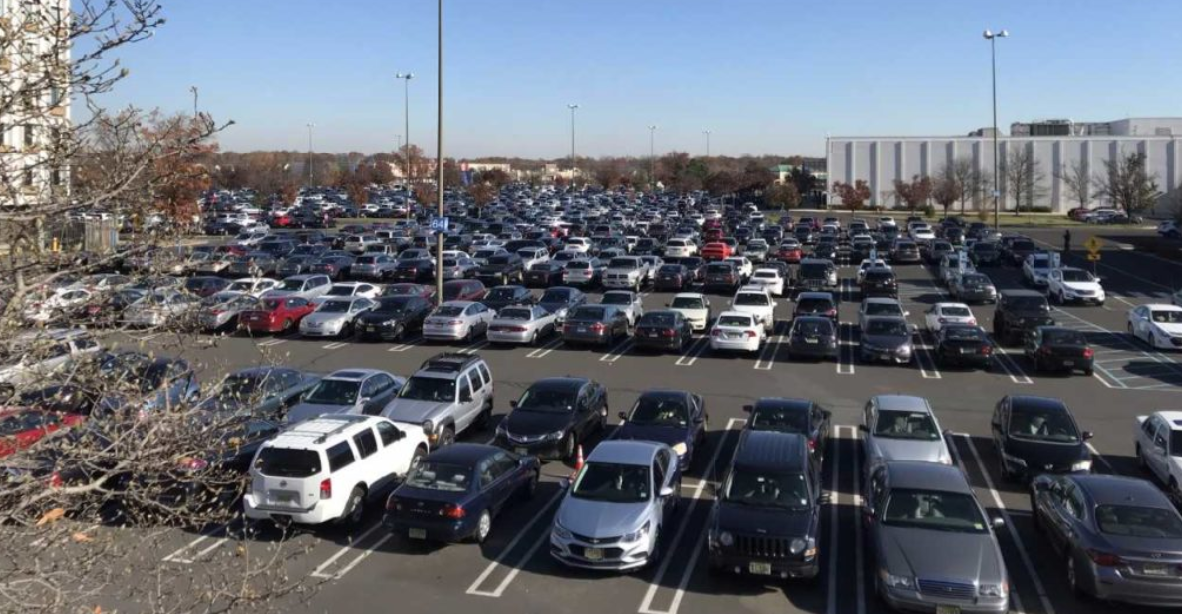
Motivation

Slide 3
Our Solution
TRACK CARS ENTERING THE PARKING LOT
The number of parking spaces in each lot is known, once we know how many cars are inside we can know how many free spaces there are
TRACK CARS ON EVERY PASSAGE-WAY
e.g. passage between different levels
This way we can keep track of how many vehicles are at each section and how many open spaces there are in each section, so we don’t have to search so hard for a parking spot.
This way parking lots can also close sections that are full or call the authorities if sections reach a stage where #parkedCars>#parkingSpaces (happens a lot in Malcha Mall on Fridays)

Slide 4
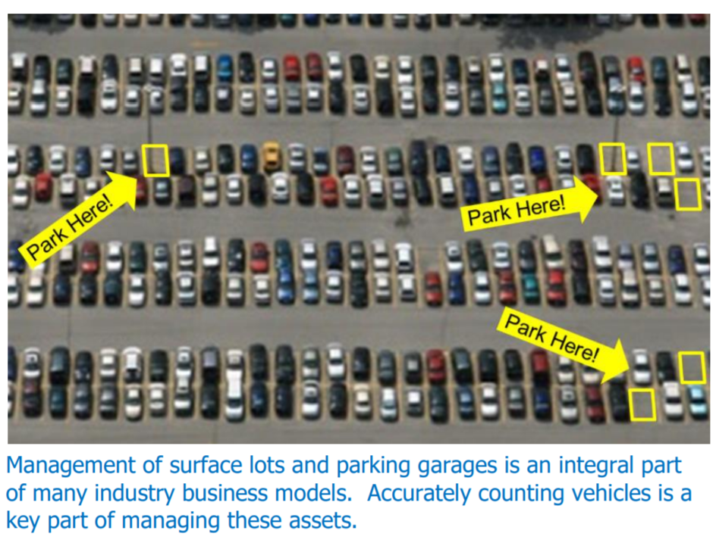
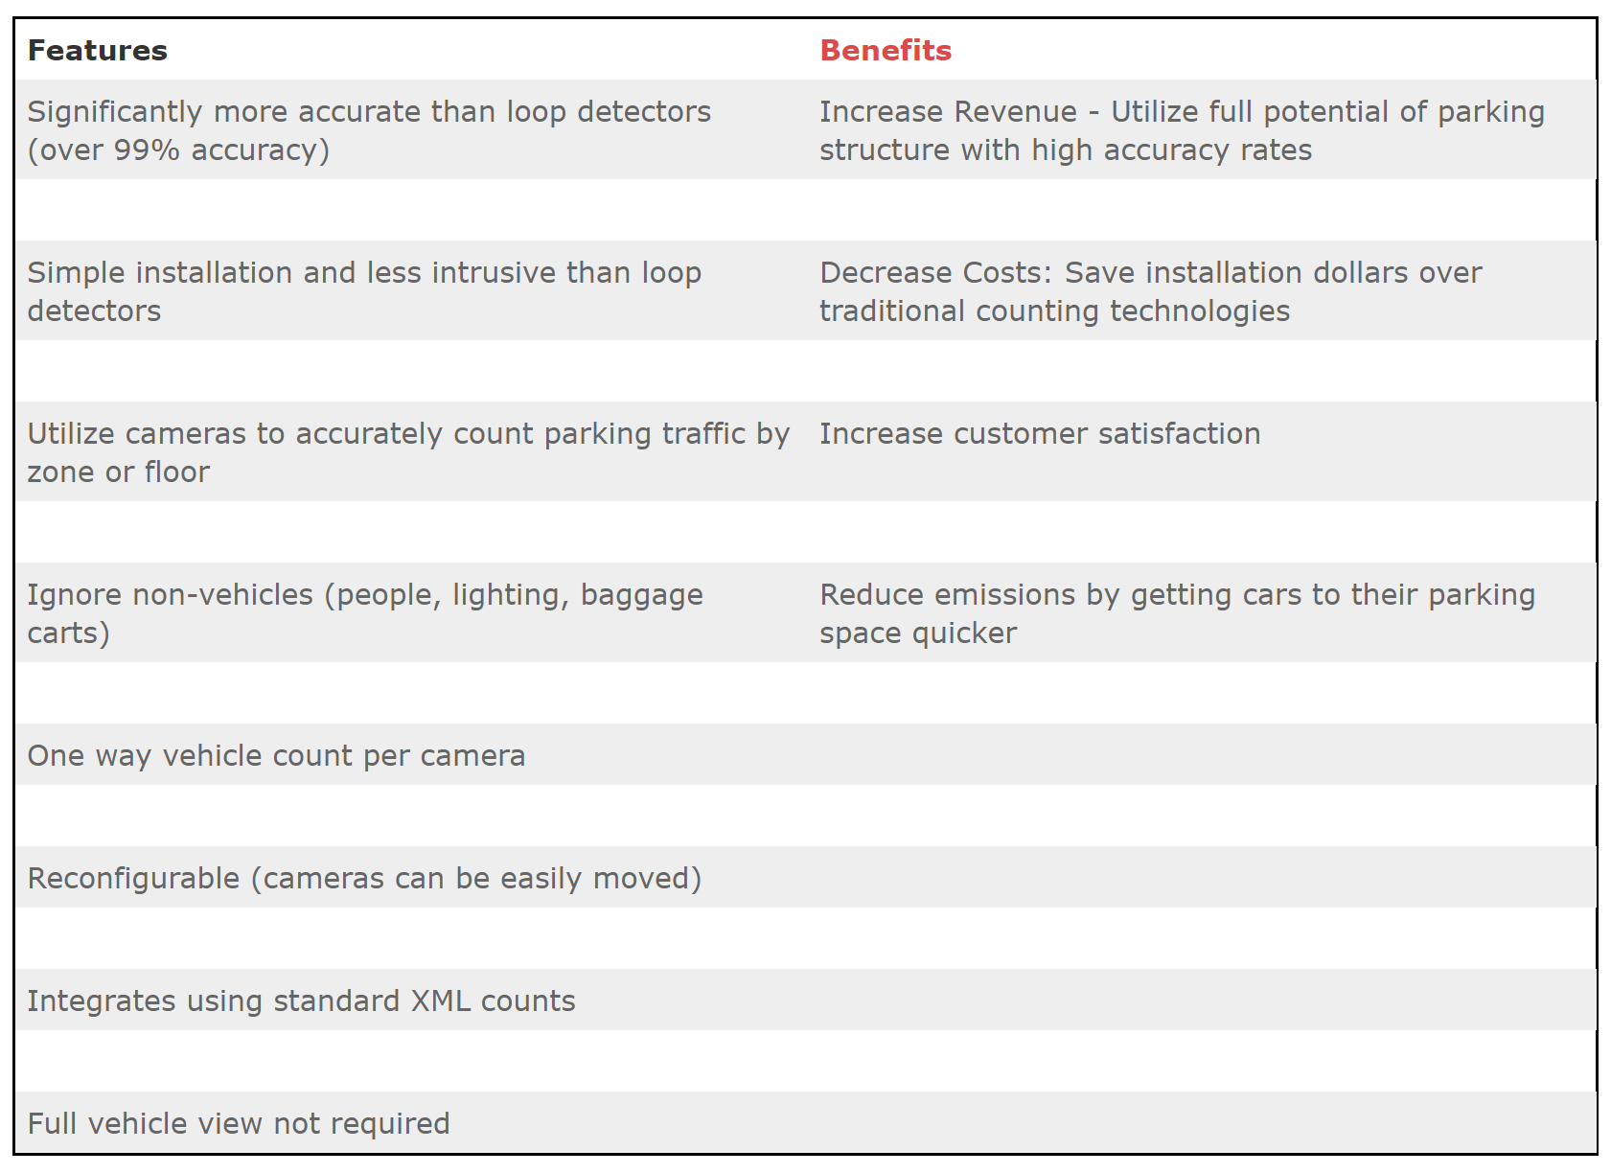
OTHER SOLUTIONS

Slide 5
GAME PLAN
Find a trained Neural Network
Detect the Cars
Use an Open Source Tracker
Track Cars that enter and exit each section
Keep Count

Slide 6
CODE SPECIFICS
Object tracker
Section
Border
Main
Centroid tracker
AtomicCounter

Slide 7
RELEVANT BACKGROUND
Neural Network
MobileNet & SSD – (next slide)
CentroidTracker
Gets rectangles as input
Prototxt – architecture
Caffe – weights & biases
Computes centroids
Computes distance between old and new centroids (close=same)
Assign new objects

Slide 8
DETECTION STAGE
ALGORITHMS
Fast R-CNNs
NEURAL NETWORKS
VGG
ResNet
MobileNet
You Only Look Once (YOLO)
Single Shot Detectors (SSDs)
Notes:
קראנו קצת באינטרנט ועשינו קצת מחקר ומצאנו 3 אלגוריתמים שונים:
https://arxiv.org/abs/1506.01497
https://arxiv.org/abs/1506.02640
https://arxiv.org/abs/1512.02325
הסיבות לפסילת אלגוריתמים או בחירתם:
קשה להבנה ולמימוש, דיי איטי
מאד מהיר, אך בעיות דיוק
מהיר ויותר מדויק מ2
מצאנו גם 3 סוגי רשתות נוירונים שונים:
למצוא ולהוסיף https://towardsdatascience.com/understanding-ssd-multibox-real-time-object-detection-in-deep-learning-495ef744fab
https://arxiv.org/abs/1512.03385
https://arxiv.org/abs/1704.04861
הסיבות לפסילת אלגוריתמים או בחירתם:
כבד וצורך יותר מדי משאבים
כבד וצורך יותר מדי משאבים
יכול לרוץ גם על מכשירים עם פחות משאבים

Slide 9
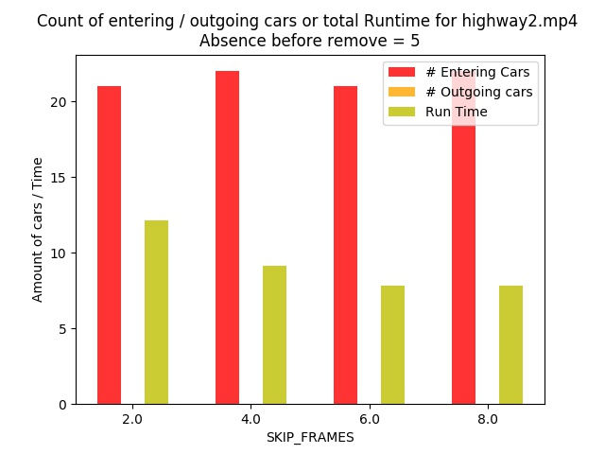
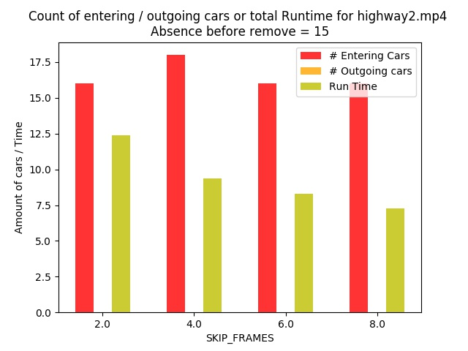
CHOOSING HYPER-PARAMETERS
Example only
Notes:
פרמטרים שהיינו צריכים לבחור:
Absence before remove
Skip frames
Confidence

Slide 10
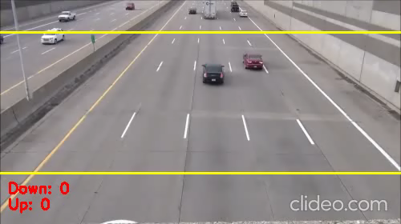
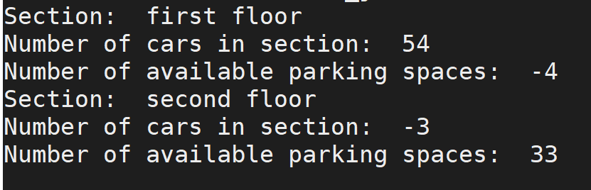
Demonstration

Slide 11

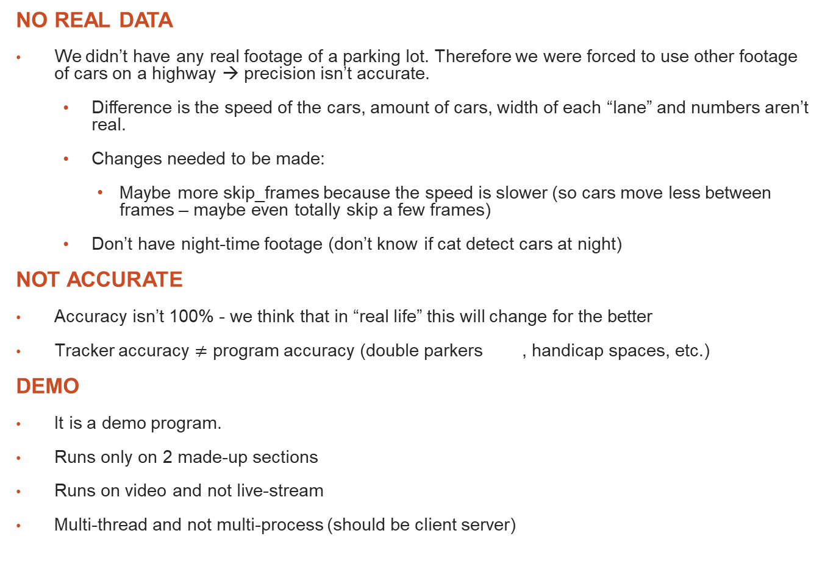
ATTENTION AREAS
NO REAL DATA
We didn’t have any real footage of a parking lot. Therefore we were forced to use other footage of cars on a highway → precision isn’t accurate.
Difference is the speed of the cars, amount of cars, width of each “lane” and numbers aren’t real.
Changes needed to be made:
Maybe more skip_frames because the speed is slower (so cars move less between frames – maybe even totally skip a few frames)
Don’t have night-time footage (don’t know if cat detect cars at night)
NOT ACCURATE
Accuracy isn’t 100% - we think that in “real life” this will change for the better
Tracker accuracy $≠$ program accuracy (double parkers , handicap spaces, etc.)
DEMO
It is a demo program.
Runs only on 2 made-up sections
Runs on video and not live-stream
Multi-thread and not multi-process (should be client server)

Slide 12

FUTURE WORK
NO REAL DATA
Before receiving real data – make sure it works in the dark (or demand will be much smaller )
After receiving real data – fix the hyperparameters to best fit (e.g. can skip more frames)
NOT ACCURATE
Accuracy isn’t 100% - we think that in “real life” this will change for the better
Have monitor on handicap spaces and calculate accordingly
Have a “Malshinon” in the app that makes double parkers double pay (with a photo or something) this way there will be fewer double parkers and more justice
More cameras that “see” all of the parking spaces (different implementation, expensive use)
DEMO
Adjust it to real-life client-server program

Slide 13
THANK YOU!

